Slide 1
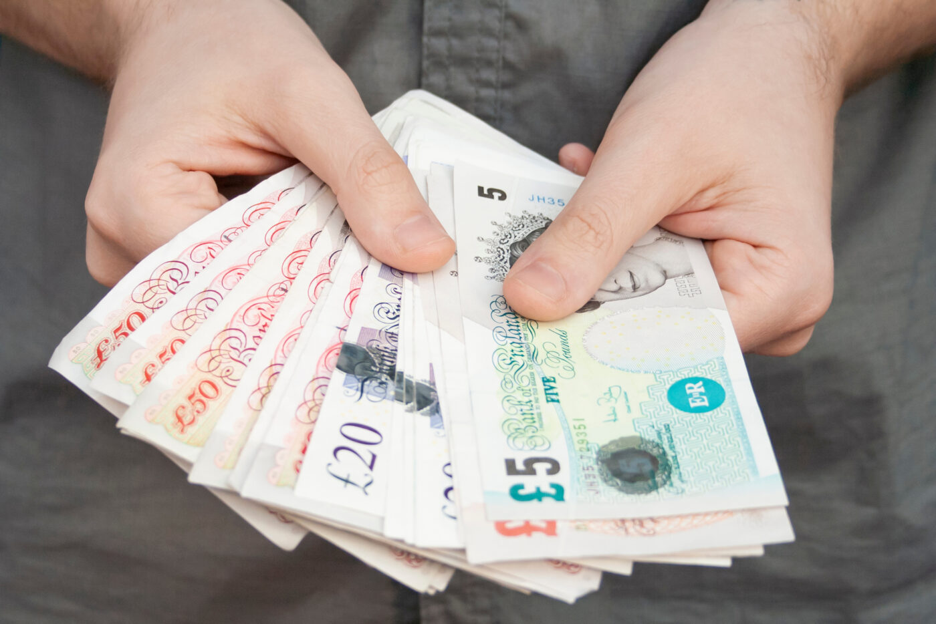


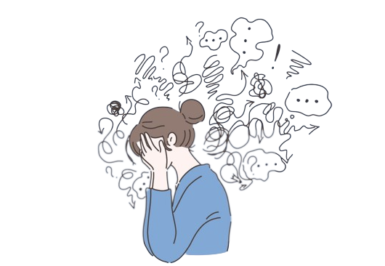
Friendship
Money
Isolation
Stress

Slide 2

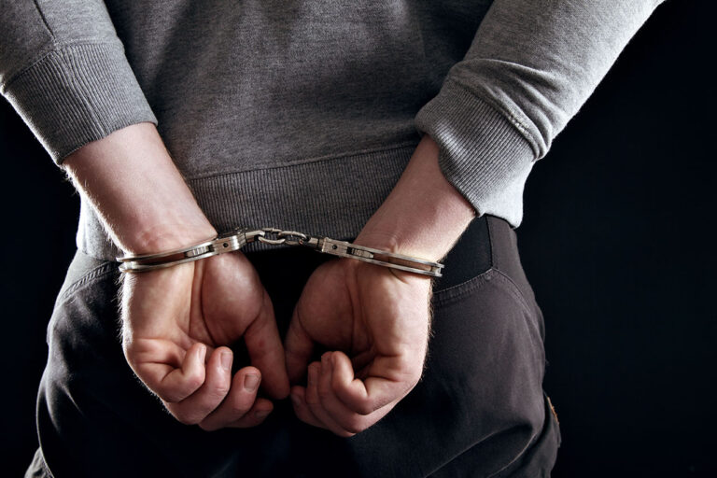


Failing school
Arrested
Phones
Happiness

Slide 3


Power
Arguments

